Slide 1

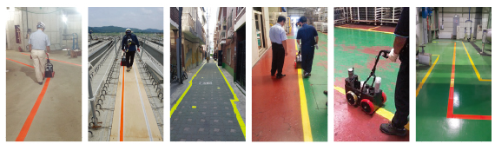
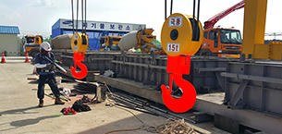



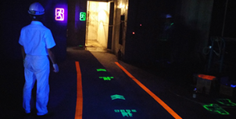
With our innovative and creative technology,
We are creating a safer world and a happier tomorrow.
Nudge Safety-Line Spray
Nudge Escape-Line Spray
Nudge Neon Spray
Line-Marking Edge Applicator

Slide 2
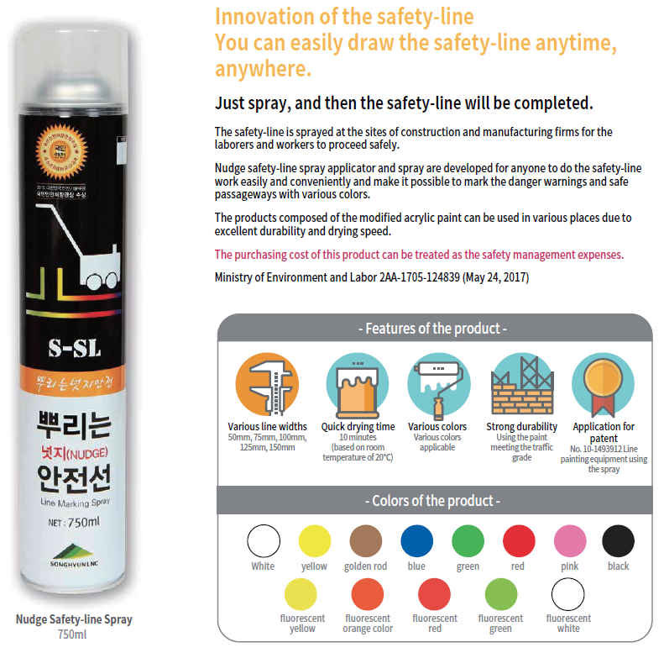

Slide 3


Slide 4


Slide 6


Slide 8
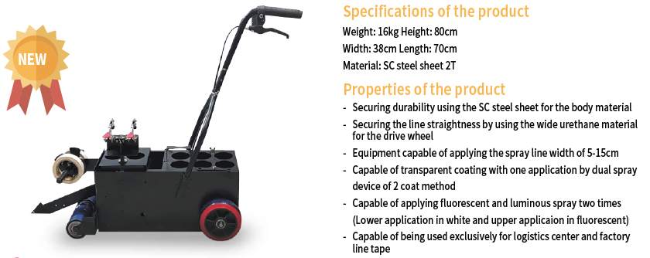

Slide 9

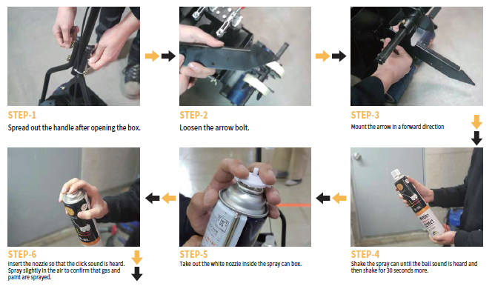

Slide 10
