Slide 1

KOMETS Business
DREAM
VISION
BUSINESS

Slide 2

CONTENTS
1
ORGANIZATION
2
BUSINESS TERRITORY
3
PRODUCT LINE.
4
AGENCY PARTNERS.

Slide 3
1. ORGANIZATION
KOMETS
PRESIDENT
Jay H. Kim
Trading & Marketing
Customer Support
SALES
Moisture & Process Analyzer
Validation /
Data Acquisition
Temperature / Pressure / Humidity / Environental
Test & Calibration

Slide 4

2. BUSINESS TERRITORY
TEST & CALIBRATION
CALIBRATION
RESEARCH INSTITUTE
QA & QC
National Calibration Lab
Same as DAkkS
Industrial R&D, University, National Research Institute
ISO Department, Production Quality Control department

Slide 5
2. BUSINESS TERRITORY
Moisture & Process
Analyzer
INDUSTRY
Gas & Compressed Air Moisture monitoring
Process Moisture Analyzer in Hazardous Area
SENSORS
INSTRUMENTATION
SYSTEM PROJECT
* Pharmaceutical
* Semiconductor
* Petrochemical
* Automotive
* Aerospace
* Shipyard
* Steel
* Petrochemical
* Refinery
* Off-shore
* On-shore
* Personal Safety
Leak detection
in all industry using gas & compressed air
Leak detection
in Sampling Gas system of Process industry

Slide 6
2. BUSINESS TERRITORY
Validation /
Data Acquisition
INDUSTRY
Validation
Data Acquisition
SENSORS
INSTRUMENTATION
SYSTEM PROJECT
* Pharmaceutical
* Food Beverage
* Cold Chain
* Meat Logistics
* Temperature
* Pressure
* Humidity
* Dataloggers
* Factory Automation /
* Onsite Calibration /
* Maintenance job
* Thermometer
* PT / Gauge
* Multichannel Recorder
* Electrical
* Meteorological

Slide 7
2. BUSINESS TERRITORY
Temperature & Pressure & Humidity &
Environental
INDUSTRY
On-line market
Off-Line Market
SENSORS
INSTRUMENTATION
SYSTEM PROJECT
* Internet Web Shopping mall
* Open market service
* Simple Products
No need training
No need delivery
No need installation
No need service
* Environmental
* Industrial
* Agriculture
* Medical
* Sensors
* Thermometer
* Barometer
* Hygrometer
* O2/CO2 detector
* Multi gas detector
* Flow/Velocity

Slide 8
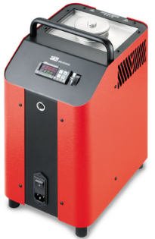
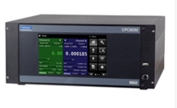
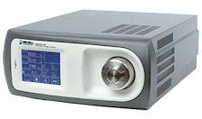
3. PRODUCT LINE
TEST & CALIBRATION
MOISTURE &
HUMIDITY
TEMPERATURE
PRESSURE
Dewpoint Calibration System
Dewpoint Hygrometer
Humidity Calibrator
Calibration Baths
Thermometry Bridge
Standard PRT
Onsite Calibrator
Dryblock Calibrator
Process Calibrator
Pressure Standard
Pressure Controller
Dead Weight Tester
Digital Reference
Pressure Handpump
Onsite Calibrator

Slide 9


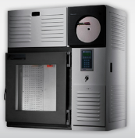
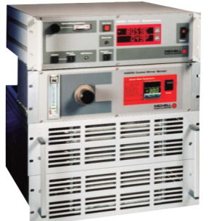

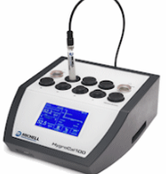
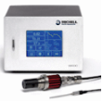
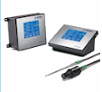
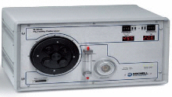
3. PRODUCT LINE
HUMIDITY &
MOISTURE
MICHELL INSTRUMENTS
DP GENERATOR
CALIBRATION CHAMBER
CHILLED DEWPOINT HYGROMETER

Slide 10


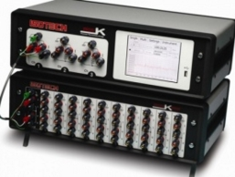
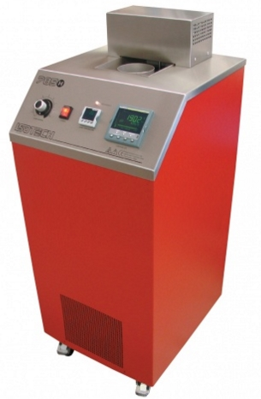
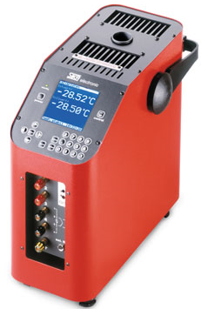

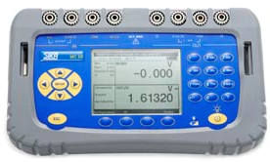
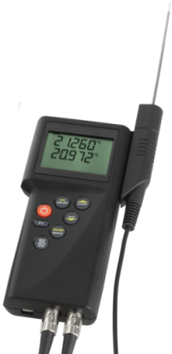
3. PRODUCT LINE
TEMPERATURE
TEMPERATURE
CALIBRATION BATHS
THERMOMETER &
SENSORS
ONSITE CALIBRATOR

Slide 11

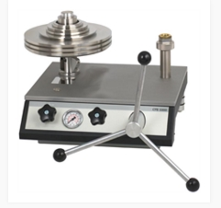
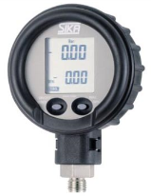
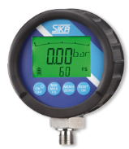
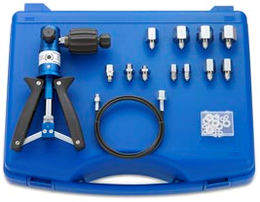
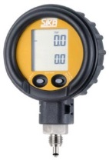
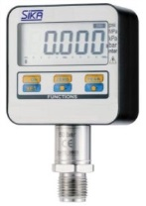
3. PRODUCT LINE
PRESSURE
PRESSURE STANDARD
ONSITE PRESSURE CALIBRATOR
Digital gauge + Hand pumps

Slide 12
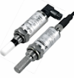
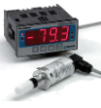
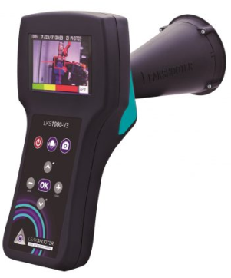
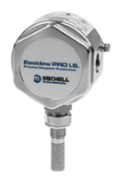
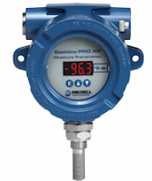

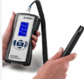

3. PRODUCT LINE
MOISTURE & PROCESS
ANALYZER
Gas & Compressed Air Moisture Monitoring
GAS LEAK DETECTOR
Ex-proof Moisture
Analyzer
Ultrasonic Gas Leak detector
This is not suitable for find leak detection.
We need alternative lproducts for fine leak detection
Dewpoint Transmitters
Portable Dewpointmeter
Humidity Transmitters
Ex-Proof Moisture Analyzer
Gas Sampling System
O2 / H2S Analyzer

Slide 13




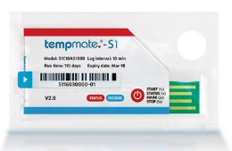
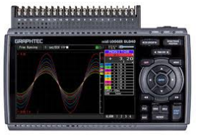
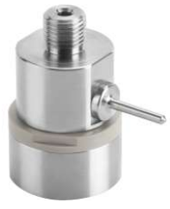
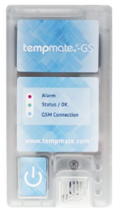
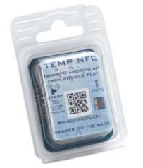
3. PRODUCT LINE
Validation /
Data Acquisition
VALIDATION
COLD CHAIN
Data Acquisition
Temperature Dataloggers
Pressure Datalogger
Single use temperature datalogger
Realt ime datalogger
NFC datalogger
Multichannel Data Recorder

Slide 14



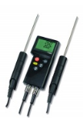

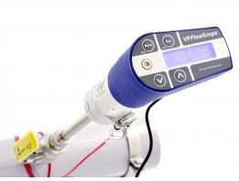



3. PRODUCT LINE
Temperature & Pressure & Humidity &
Environental
On-line market
Off-line Market
Off-line Market
Thermometer
Barometer
Hygrometer
GAS FLOWMETER
Flow/Velocity
O2/CO2 detector
Need Gas detector
Simple products selling throught KoMetS shopping Mall & Open market

Slide 15




4. AGENCY PARTNERS
TEMPERATURE & PRESSURE CALIBRATOR
ALL OF GAS MOISTURE & HUMIDITY PRODUCTS
VALIDATION DATALOGGERS
ULTRASONIC GAS LEAK DETECTION CAMERA
ULTRASONIC GAS FLOWMETER
COLDCHAIN DATALOGGER
WATER IN OIL SENSOR
INDUSTRIAL DATALOGGERS
UNIVERSAL INSTRUMENTS FOR ONLINE MARKET
PRESSURE STANDARDS & CALIBRATORS
HUMIDITY CHAMBER
TEMPERATURE STANDARDS & CALIBRATORS

Slide 16
THANK YOU
For LISTENING
DREAM
VISION
BUSINESS

