Slide 1

Company introduction
Marine Industry
2020.03.11
www.welding.kr

Slide 2
CONTENTS
01
General
Profile / History / Organization / Equipment
02
Product
Ships / Aluminum structures / Others
03
Manufacturing process
Ships / Aluminum structures
04
Major Sales
Ships / Aluminum structures / Certificates

Slide 3
01
General
Profile
History
Organization
Equipment

Slide 4
1. Profile
Business information
CEO
Employees : 11
Capital : 50M won
Sales : 1.57B won(2019)
Product :
Division of Aluminum structure
: Aluminum scaffolding, Step foothold, ladder, Exhibition booth, Truss for outdoor stage, etc.
Division of Ship/Yacht
: Fishing boat, Vessel, Power boat, Yacht, river boat, etc.
Cho
Byeong woo
Business No.
321-88-00720
Address
511, Jinbuksaneop-ro, Jinbuk-myeon, Masanhappo-gu, Changwon-si, Gyeongsangnam-do
TEL
055-271-8806
FAX
055-271-3056
Homepage
www.welding.kr

Slide 5
2. History
• Apr 2014 Established Marine Industry
• Jun 2014 Launched open-market online sales
• Apr 2017 Registered in KITA
• May 2017 Transferred patent technology to Dong-A Uni.
• Jun 2017 Claimed as a vendor from Samsung Elec. & Hyundai Oil Bank
• Jul 2017 Established Marine Industry Co., Ltd. (Transferred with expansion)
• Aug 2017 Business agreement on oversea branching in Silicon Valley
• Dec 2017 Certified as venture company and established research center
• Mar 2018 Attended ‘Made in Changwon’ festival in 2018(PR)
• May 2018 Entered a store in Amazon
• Dec 2018 Achieved 1 billion sales
• Mar 2019 Certified ISO 9001, ISO 14001
• Jul 2019 Signed support business for patent of Gyeongnam Intellectual Center
• Dec 2019 (In progress) KC certification for aluminum structures
• Dec 2019 Signed support business for smart factory
• Feb 2020 Applied for a patent on aluminum structures/design on boats
• Mar 2020 (In progress) Oversea branching in Melbourne
• Oct 2020 Aluminium Workboard Certified KCS(20-AV2BP-0256)

Slide 6
3. Organization
CEO
Research
Laboratory
Production
/Quality
General sales
Management support
Ship
Structure
Organization chart
CEO
Cho BW
General management– Management/Sales
5 years of Aluminum welding
Shin JY
Dep. Manager
General production for Aluminum
Quality & Production management
Park SC
Dep. Manager
General production for shipbuilding
Quality & Production management
15 years in Ship industry
15 years of shipbuilding welding
10 years of FRP related
Park MG
Director of Lab.
10 years of governmental project
Evaluation committee in MSS
General R&D for governmental project

Slide 7
4. Equipment (2020.03.11 Now)
Equipment | Propose | No | Remark
Cutter | Part cutting | 3
Welder | Aluminum welding | 6
Assembly jig | Aluminum structure welding | 3
Lathe | Aluminum rounded-pipe processing | 1
Bender | Aluminum pipe bending | 1
Milling | Aluminum small-sized parts processing | 1
CNC Carver | Aluminum parts processing | 2
Bener | Aluminum pipe bending | 1

Slide 8
02
Product
Ships
Aluminum structures
Others

Slide 9
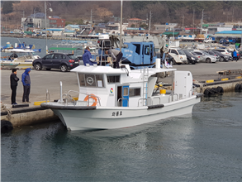
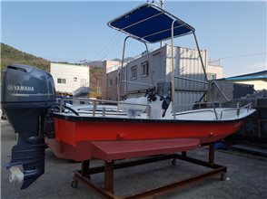
1. Ships
Type | Patrol ship
Client | Fishery technology office
Tons | 4.99 ton
Length | 10m
Width | 3.1m
Depth | 0.8m
Engine | 448 HP
Propulsion | Water jet
Max. velocity | 20 Knots
On board | Over 6
Type | Leisure & Fishing boat
Client
Tons | 0.71 ton
Length | 6.52m
Width | 1.63m
Depth | 0.66m
Engine | 30 HP
Propulsion
Max. velocity | Over 25 knots at 90 HP
On board | Over 4

Slide 10
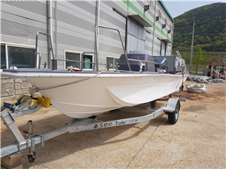
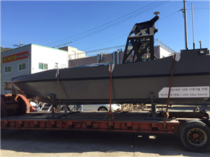
1. Ships
Type | Leisure & Fishing boat
Client
Tons | 0.87 ton
Length | 6.93m
Width | 1.97m
Depth | 0.8m
Engine | Over 30 HP on average
Propulsion
Max. velocity | Over 25 knots at 90 HP
On board | Over 4
Type | War ships (Confidential)
Client
Tons
Length
Width
Depth
Engine
Propulsion
Max. velocity
On board

Slide 11
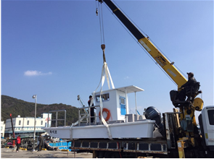
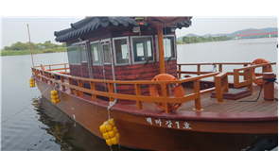
1. Ships
Type | Ships for floater removal
Client | Gyeongnam JinJu
Tons | 2.1 ton
Length | 7m
Width | 3m
Depth | 0.65m
Engine | 150 HP
Propulsion
Max. velocity | 25 knots
On board | Over 3
Type | Yellow sailboat(Cruise ship)
Client | Buyeo County Office
Tons | 12 ton
Length | 14.5m
Width | 4m
Depth | 1.2m
Engine | 250마 HP
Propulsion
Max. velocity | 7~10 knots
On board | Over 13

Slide 12
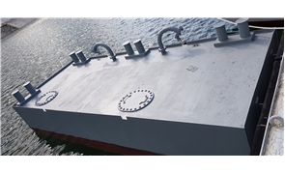
1. Ships
Type | Offshore floating structure(Barge)
Material | FRP, Steel, Aluminum
Length | Expandable according to use
Width | Expandable according to use
Depth | Expandable according to use

Slide 13
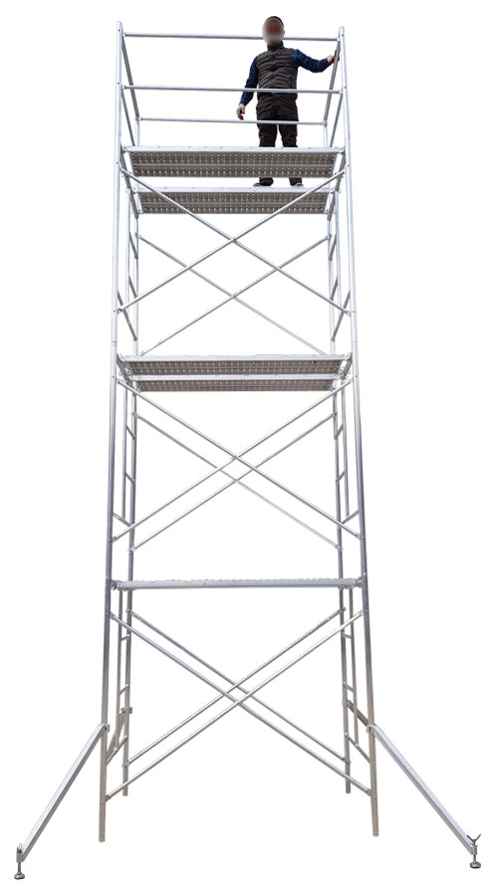
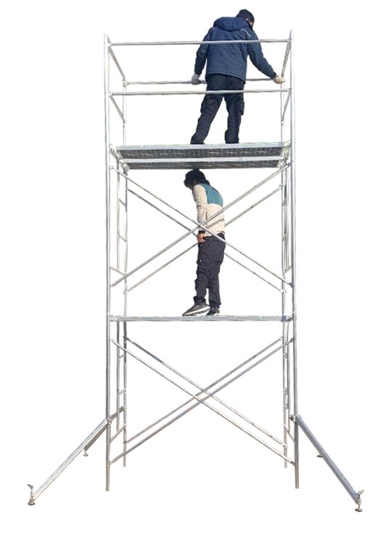
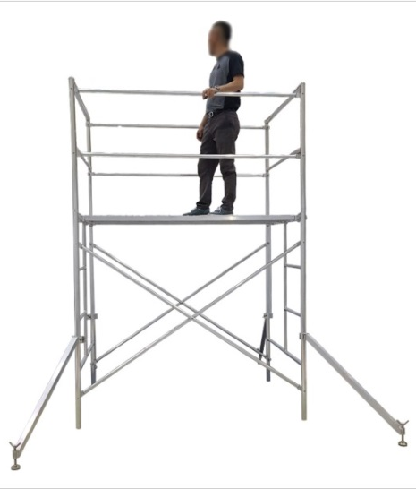
2. Aluminum structures
□ Aluminum scaffolding
Single-stage
Two-stage
Three-stage

Slide 14
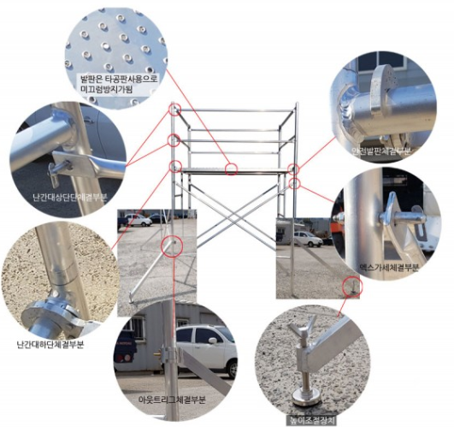
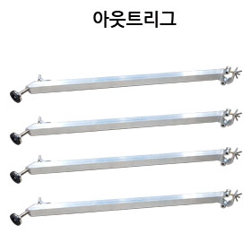
2. Aluminum structures
□ Aluminum scaffolding structure

Slide 15
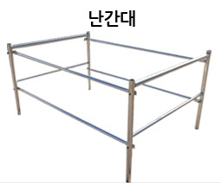
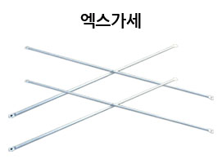
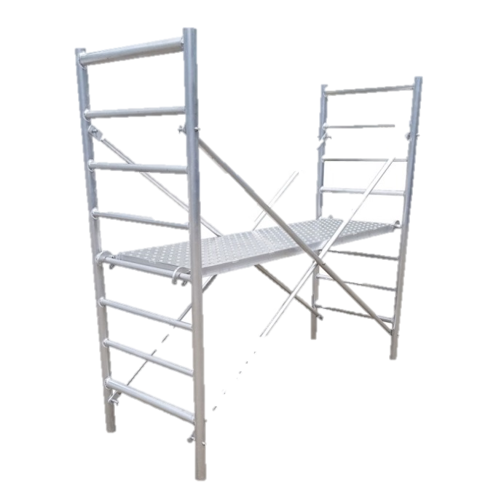
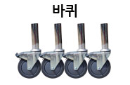
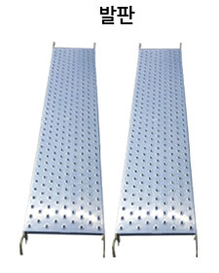
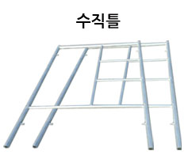
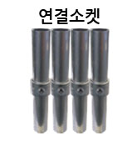
2. Aluminum structures
□ Single-piece Aluminum scaffolding structure

Slide 16
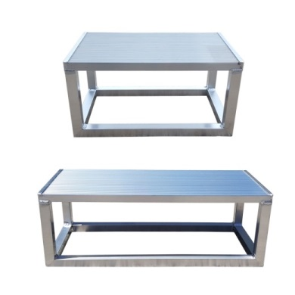
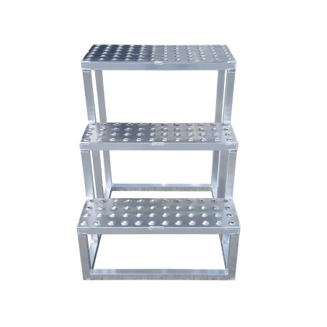
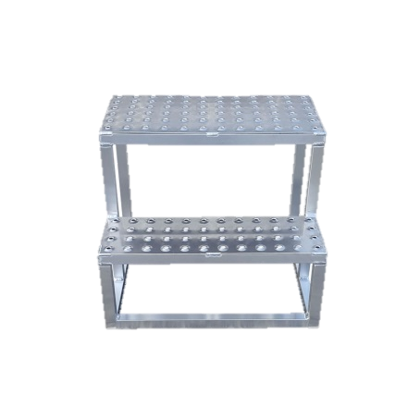
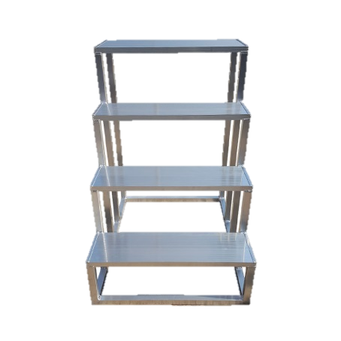
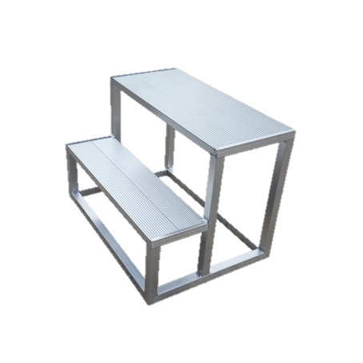
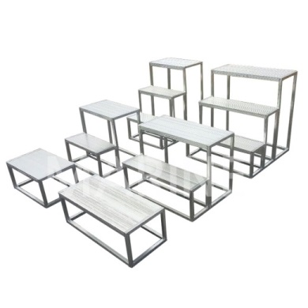
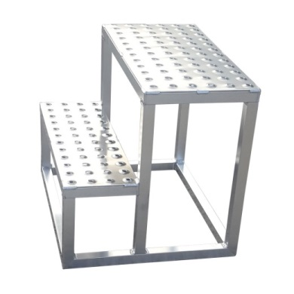
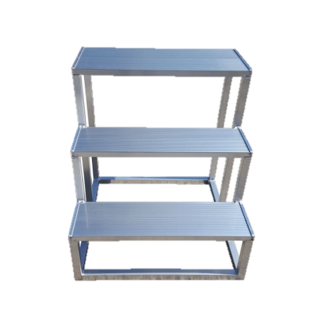
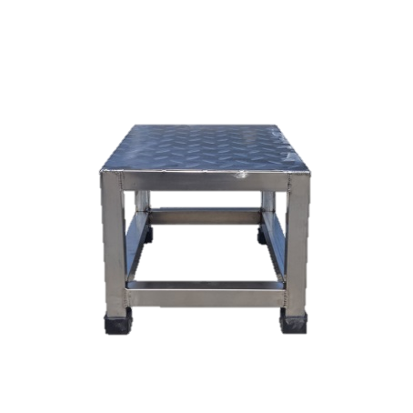
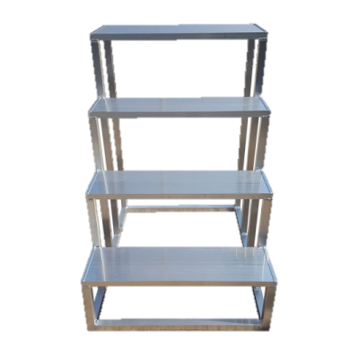
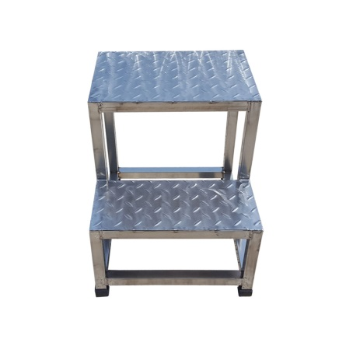
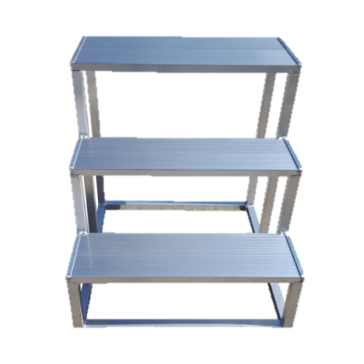
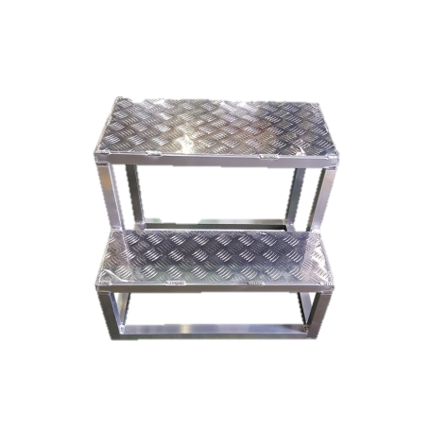
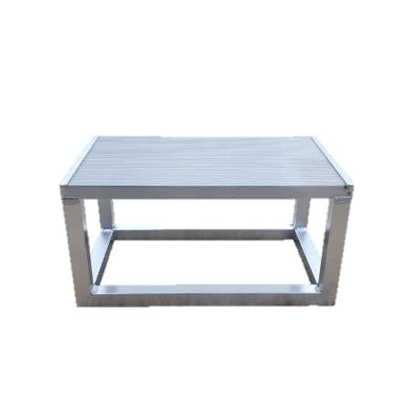
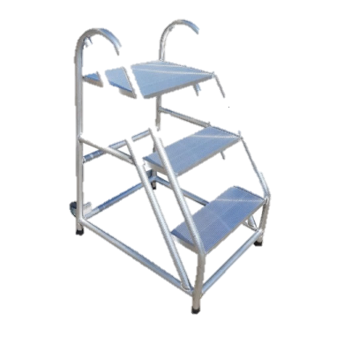
2. Aluminum structures
□ Aluminum stairs

Slide 17
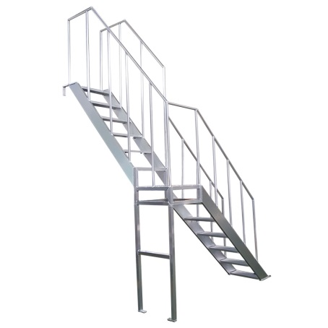
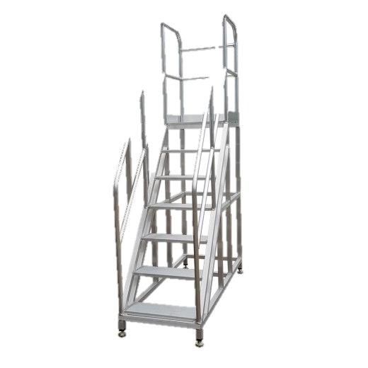
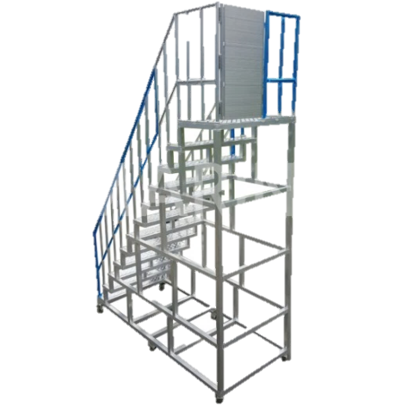
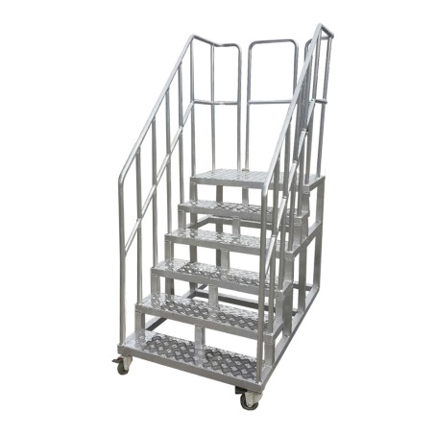
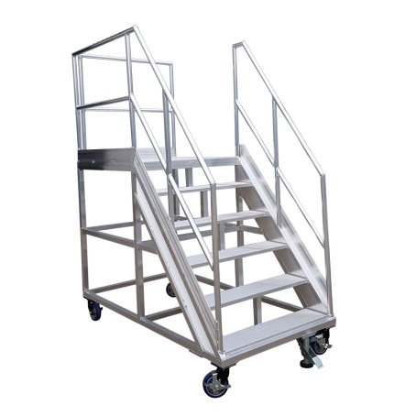
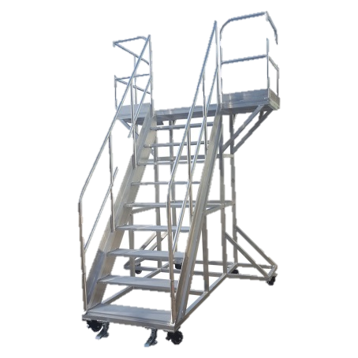
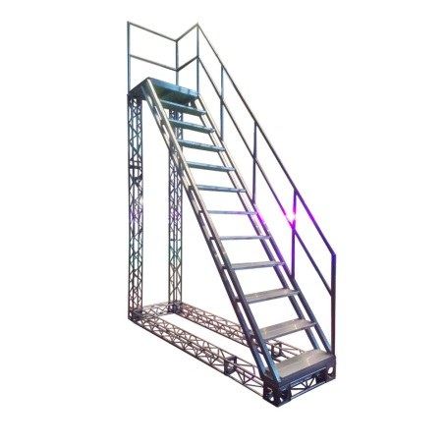
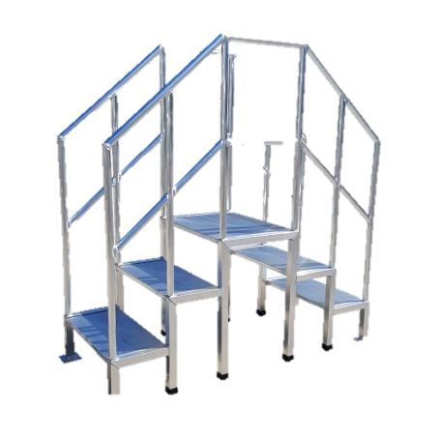
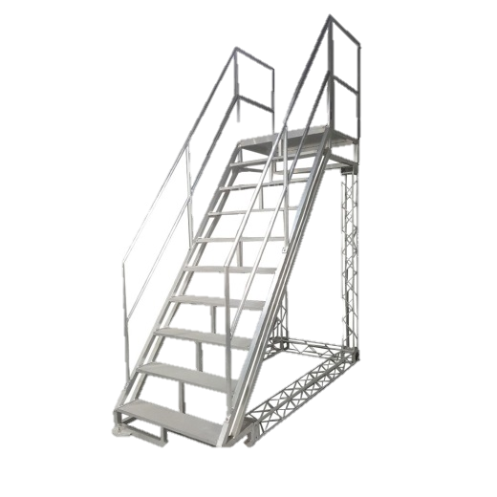
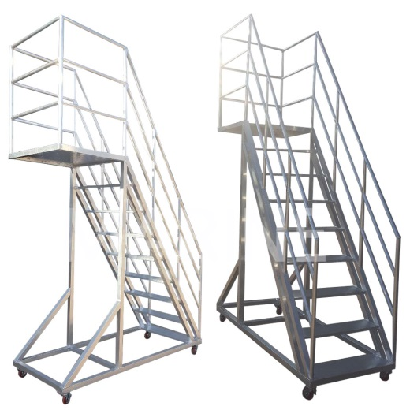
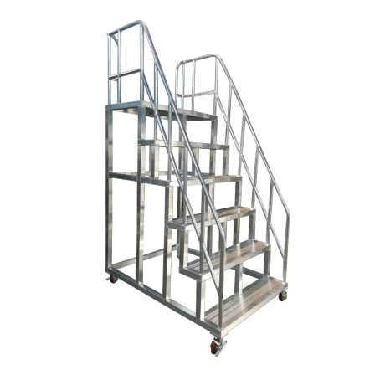
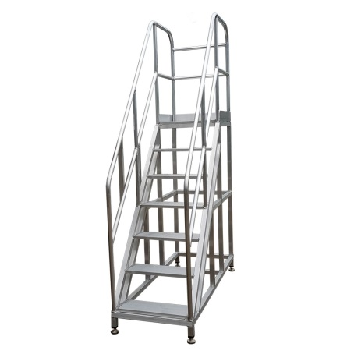
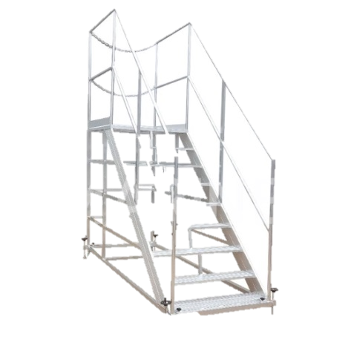
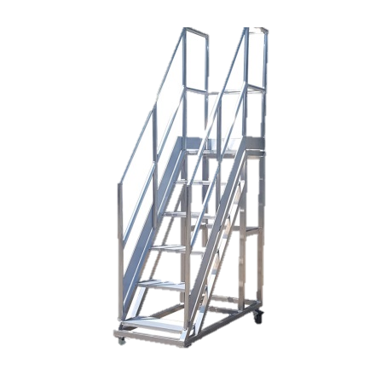
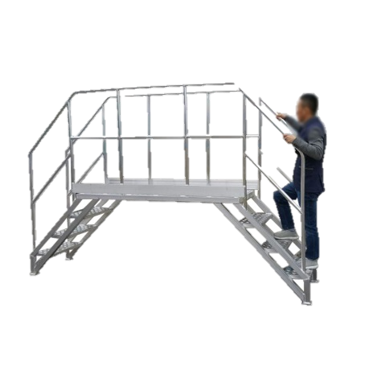
2. Aluminum structures
□ Aluminum stairs(On demand)

Slide 18
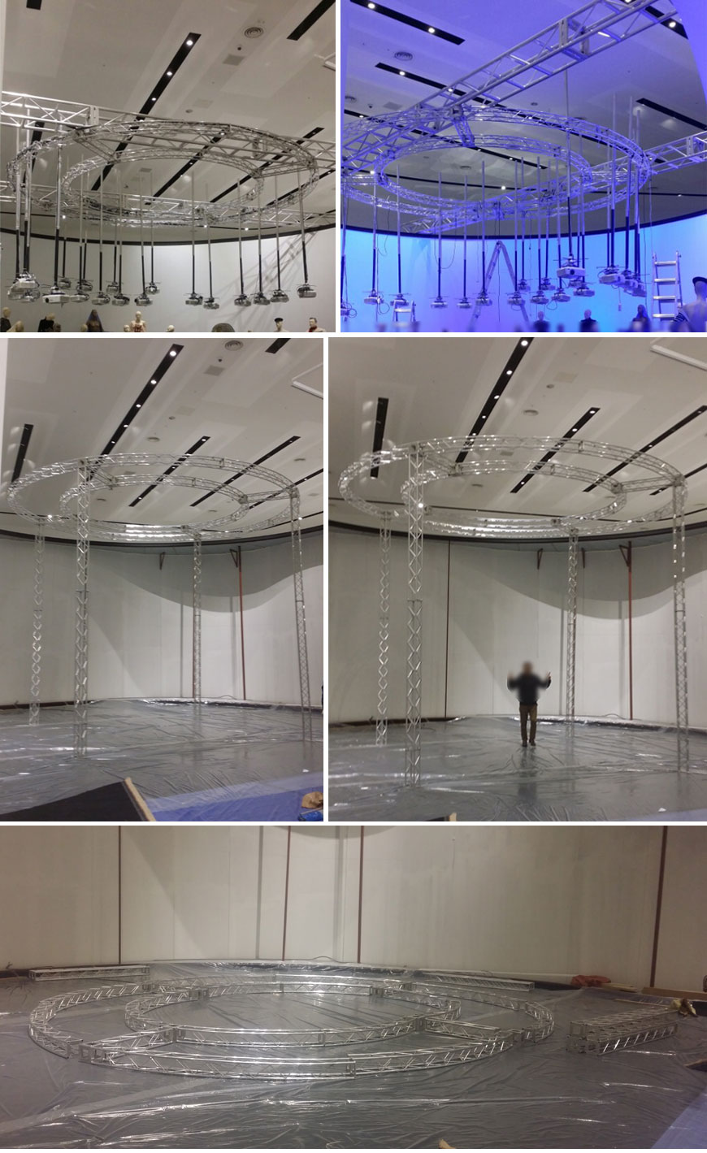





2. Aluminum structures
□ Truss

Slide 19



3. Others
□ FRP composite pool

Slide 20






3. Others
□ Pool stairs (Stainless steel)

Slide 21


3. Others
□ Safety net stairs (Stainless steel)

Slide 22
03
Manufacturing process
Ships
Aluminum structures

Slide 23

1. Ships
□ Small-sized ships’ drawing

Slide 24









1. Ships
□ Manufacturing process
1. Linear design & drawing approval
2. Material Receiving
3. Inspection
4. Mock-up
- Structural design/analysis
- Material check
- Velocity & on-board numbers
- Engine spec check
- Man-day check
- Drawing check
- O.D. check
- Equipment check
- Material check
Resin component check
- Gelcoat component check
5. Coating & Sanding
6. Gelcoat coating
7. Resin applying & molding
8. Finished product & Testing
9. Shipment/Delivery
- Dimension check
- CNC processing
- Coating check
- Process check
- Coating amount check
- Coating thickness check
- Thickness quality check
Resin applying thickness
check인
Appearance check
- Product number check
- Appearance check
- Major dimension check

Slide 25


2. Aluminum structures
□ Aluminum stairs (On demand)

Slide 26

2. Aluminum structures
□ Aluminum bench

Slide 27







2. Aluminum structures
□ Manufacturing process
1. Design & Approval
2. Material Receiving
3. Inspection
4. Cutting
- Dimension check
- Material check
- Str. analysis review
- Sub. material check
- Length, ID/OD check
- Material check
- Damage, debris check
- Mill Sheet check
- Material check
- Length, shape check
- Equipment check
- Cutting blade check
5. Bending
6. Part processing
7. Welding
8. Assembly & Testing
9. Shipment/
Delivery
- Material check
- Damage check
- O.D. check
- Equipment check
- Material check
- CNC program
- CNC processing
- Process check
- Material check
- Welding rod check
- Welder check
- Welding jig check
- Product number check
- Appearance check
- Major dimension check

Slide 28
04
Major sales
Ships
Aluminum structures
Certificates

Slide 29
1. Ships
 | Clients | Specification
1 | Rescue ship, Ulsan city | 27 ton
2 | Cruise ship, Buyeo County Office, Chungnam | 12 ton
3 | Boat, Daejeon city | 2 ton
4 | Fishery patrol ship, Fishery technology office, Gyeongnam | 4.99 ton
5 | Namgang cleaning ship, Jinju city, Gyeongnam | 2.1ton
6 | FRP septic tank, KTL | 300 on board
7 | Patrol ship, Imsil County Office, Jeonbug | 5.27 ton
8 | FRP pool, KCC | 12M
9 | Indong dam patrol ship, K Water | Barge
10 | Ocean research vessel, KIOST | 3 ton
11 | Floating solar patrol ship, KTL | 0.78 ton

Slide 30
2. Aluminum structures
 | Clients | Specification
1 | Hanwha Research Institute | Bench
2 | Lotte construction | Bench
3 | Truss, Changwon city | Truss
4 | Chungnam provincial office | Boat ladder
5 | Korail networks | Bench
6 | Changwon branch, EX | Bench
7 | Bank of Korea, Chungbuk headquarters | Bench
8 | Hanwha Defense | Bench
9 | Hyundai Rotem | Bench
10 | KAC(Seoul, Busan) | Scaffolding set

Slide 31







3. Certificates

Slide 32




3. Certificates

Slide 33
Marine Industry has adopted a double safety ring for safety scaffolding so that the scaffolding does not deviate even in difficult-to-predict situations. It has passed the safety evaluation in Korea to promote worker safety.
Compared to the widely used iron scaffolding, aluminum is used as a material to realize weight reduction. In addition, the light weight also reduces transportation costs.
Since it is manufactured using materials with strong properties against rust and corrosion, if you look at the long-term point of view, it is economical because the replacement time of equipment is long. Compared to stainless steels with similar properties, they can be supplied at a much lower price.
It is eco-friendly. It is eco-friendly compared to other products because it can be used semi-permanently compared to iron scaffolding.
It is non-magnetic and can be installed in environments (electric and electronic factories) where no magnetic material should be expressed.

Slide 34
Our company has been manufacturing sub-materials and non-ferrous metal structures related to ships since 2017, and is composed of people who have worked in the same industry for more than 15 years on average.
It is equipped with factory facilities that can be directly produced, and thus it is possible to supply high-quality products at low prices to customers by implementing transparent and clear manufacturing cost calculations and eliminating intermediate transaction margins.
We are pursuing the best service based on quality first, based on trust and faith in customers with obtaining related patents and internationally recognized certificates.
Marine industry is constantly researching and making better products. We will always remain the best partner to think and act first from the customer's perspective.
Thank you

Slide 35
Thank
You

